Slide 1

SMALL BUSINESS DEVELOPMENT CENTER
(SBDC)
PROGRAM OVERVIEW

Slide 2


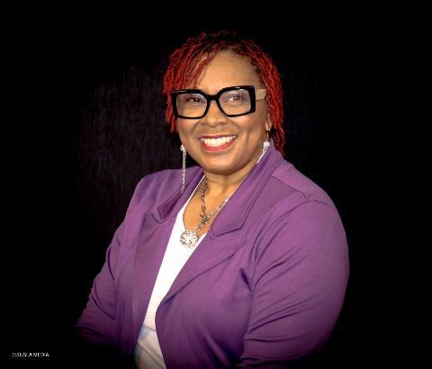

Shannon Levingston
Training Coordinator

Slide 3
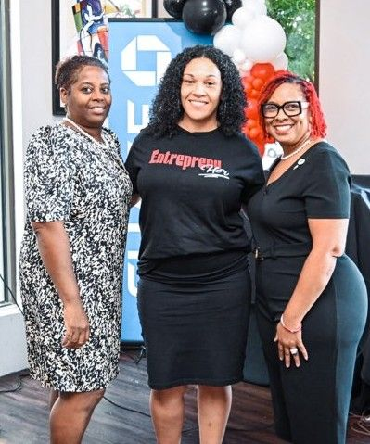
MEET OUR TEAM
Amanda Flynn, Director
Pamela Jackson, Business Advisor

Slide 4

America’s SBDC represents America’s nationwide network of Small Business Development Centers (SBDCs) – the most comprehensive small business assistance network in the United States and its territories.

Slide 5
Overview
Established by Congress in 1980
Leverage federal, state and higher education resources
62 programs operating in 50 states and US territories
Provide business advising for entrepreneurs and small business
owners at all stages of development and in all sectors
Provide access to world class research for decision making
Accredited Organization
A partnership program with the U.S. Small Business Administration, Louisiana Economic Development and participating universities

Slide 6


SUSLA SBDC - Funding Partners
Notes:
Our Resource Partners:
Federal grant funding from the Small Business Administration (SBA)
State grant funding from the State of Texas (a business-friendly state)
Our local host institution is the Dallas County Community College District

Slide 7
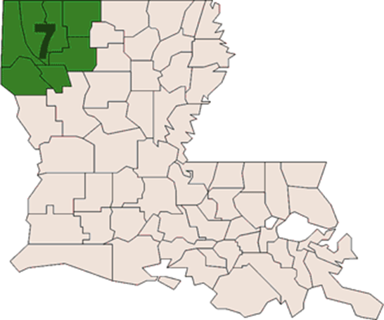
SUSLA SBDC – Territory/Parishes Served
CADDO
BOSSIER
WEBSTER
CLAIBORNE
BIENVILLE
RED RIVER
DESOTO

Slide 8



SUSLA SBDC - Services
START
GROW
SUSTAIN
SMALL BUSINESS

Slide 9
What We Provide
Business Advising Start-Up Assistance
Accounting Tax Planning
Budget Planning *Technology/Computers
Cash Flow Management Market Research
Customer Relations Business Plan Development
*eCommerce Marketing Strategy
Franchising Training Workshops
Government contracting Cybersecurity
Managing a Business Loan Package Development
Human Resources &
Organizational Development
A partnership program with the U.S. Small Business Administration, Louisiana Economic Development and participating universities

Slide 10

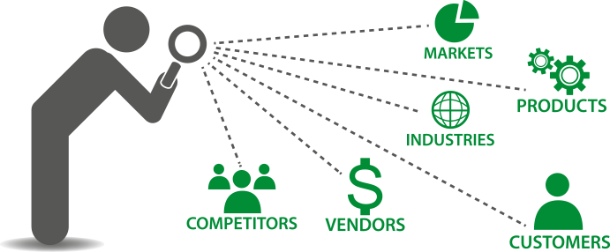





SUSLA SBDC – Client Services
TRAINING & EDUCATION
MARKET & INDUSTRY RESEARCH
BUSINESS COUNSELING & PLANNING
FINANCIAL MODELING & PROJECTIONS
BUSINESS MODEL EVALUATION & DEVELOPMENT
SALES & MARKETING STRATEGIES

Slide 11
CLIENT TYPES PRE-VENTURE & STARTUPS
Do you have what it takes?
What business should you choose?
What do you need to succeed in business?
How much money do you need to get started?
What is a business plan and why do you need one?

Slide 12
ORGANIZING YOUR BUSINESS
Determine your Legal Structure
Sole Proprietorship
Partnerships
Corporations
Limited Liability Company (LLC)
Non-Profit Corporation
Search Name & Register with Secretary of State - https://geauxbiz.sos.la.gov/
Obtain a Federal Identification Number from Internal Revenue – http://www.irs.gov
Choose a Bank – Set up Business Bank Account
QuickBooks or other Bookkeeping Software ( IRS requirement)
Agencies
A partnership program with the U.S. Small Business Administration, Louisiana Economic Development and participating universities

Slide 13
CLIENT TYPES EXISTING BUSINESSES
Strategic Growth Planning
Operational Efficiency
Financial / Profitability Analysis
Human Resource Issues
Corporate & Government Contracting
Certifications – 8(a), Woman, Minority, Veteran

Slide 14
How We Measure Results
Unique Clients Served
Businesses Started
Capital Acquired
Jobs Supported.
A partnership program with the U.S. Small Business Administration, Louisiana Economic Development and participating universities

Slide 15
How do we ensure annual Economic Impact goals are met? LENDER RELATIONSHIPS ARE IMPORTANT!!!
LENDERS
in return, lenders encourage clients that ARE closing on deals to consult with SBDC prior to closing.
SUSLA SBDC
offers a “holding place” for lender’s clients, not yet ready to close on loans.
Beneficial, Value Added Relationships with Lenders, Local Gov’t, Chambers, and Other Small Business Orgs. in Our Region
Efficiently/Effectively covering our 7 parish region with resources provided!

Slide 16
Partnerships are critical to
Supporting client success!
Our Partners:
SBA Resource Partners & SBA District Office
Local Partners
*Chambers of Commerce
* Local Banks
*APEX
*EAP
*Cohab
*Fair Share
A partnership program with the U.S. Small Business Administration, Louisiana Economic Development and participating universities

Slide 17
TESTIMONIALS
“Working with Ms. Flynn at the SBDC was priceless. Her knowledge and connections helped me with my business expansion.” – Felton Colar, Ergon Construction, LLC.
“The SBDC was instrumental in guiding us through the lending process.” – Bernie Woods, Woods Holding, LLC.
“Pamela Jackson, your strategic approach resulted in a business plan and financial projections that is well-structured for our trucking company. It’s evident that you and the team at SBDC takes great pride in your work and genuinely care about the success of your clients.” – James and Chillon Caraway, Cajun Creek Transport, LLC
A partnership program with the U.S. Small Business Administration, Louisiana Economic Development and participating universities

Slide 18
Let’s Get Started on Your Plan!
CONTACT SUSLA SBDC
318-670-9700 or
visit our website at
www.lsbdc.org
QUESTIONS ????
A partnership program with the U.S. Small Business Administration, Louisiana Economic Development and participating universities.

